Slide 1



Earth (Spam) as a Character Gallery
Elif Kaya
Notes:
Thanks for attending my presentation, "Earth (Spam) as a Character Gallery", where we go on a world tour to find the who, what, why, where and how of scaled abuse. We'll learn how it proliferates, why it's getting worse, and how we can make it better through understanding the characters at play and what makes them unique and sharing their lore with others.

Slide 2
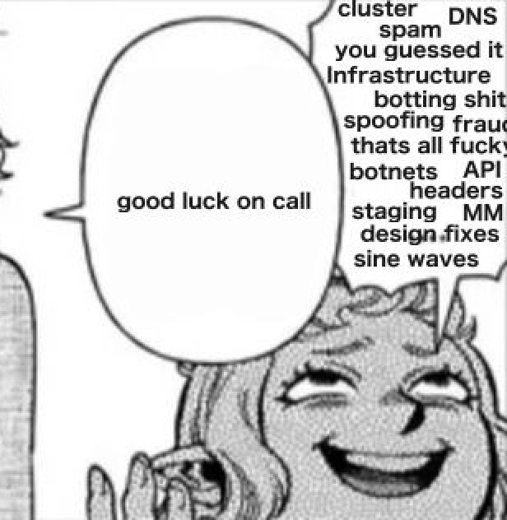
WHOAMI
Bumblebreaches.com
Notes:
I'm a scaled abuse specialist of many forms. I currently am a scaled abuse engineer at Discord.
I've worked in a variety of roles and you can find more about that on my website to save us some time here.
In the context of this talk, I've run the gamut of tearing down, tracking and writing mitigations and reports for malware, phishing, botnets, fraud, spam, ad abuse, and all sorts of other scaled abuse for blue teams, large enterprise, independent research, B2B, and now general consumer protection.
I love digging into scaled abuse, how the beauty of networking and internet bad-practice comes together to make a nasty soup.

Slide 3
Disclaimer
Notes:
As a Disclaimer I am not here as a representative of Discord. I will be discussing issues that impact all online platforms, not just social media, and they are informed by my experiences but critically this talk will not involve tactical details on bot detection specifics that is done through the detection of inauthentic activity and requests.
There are other talks and resources at the end on that topic for those getting started and I am always happy to get down to business and nerd out on bot-or-not over coffee, so feel free to connect later.

Slide 4
Defining Terms
Agenda
1
Some Issues and Needs
2
Taxonomy: L.O.R.E.
3
Spamfighting Case Studies
4
Resources + Q&A
5
Notes:
For our agenda we're going to dive deep so we'll be starting with basic terms, and a state of the world to get us all on the same page.
Then we'll dig into why we need to reframe how we look at creating and writing mitigations and designing online platform features.
And in order to power that reframe, we'll be exploring a proposal for a "Spampedia" called L.O.R.E and the concept of spam "User Journeys" where we'll walk through numerous case studies from threat actors pursuing scaled abuse to understand how to give them a better (worse) experience.
Then we'll close out with resources for new and old platforms alike to understand more of what we talked about today or go out and learn and deploy some spamfighting today.

Slide 5

Defining Terms
Notes:
If there are no Revolutionary Girl Utena fans in the audience me and my slides will be heartbroken.
On to terms.

Slide 6
Platform
Basic Terms
A service or a collection of services typically that allow access to individual features or resources. This could involve social, games, email, storage, or purchasing, or tools. These are usually accessible via accounts
Safety & Security
Overlapping. Contested. Security focuses on securing core platform code, development, and internal systems & accounts. Safety focuses on safeguarding features, users, and visible content
Spam & Scaled Abuse
Scaled abuse is any means of exploiting a platform via automation, organization of many manual resources, or disparate widespread use of a feature to commit harm. Spam (or account theft) is typically a form of scaled abuse concerning nonconsenting or deceitful interactions but can be as a placeholder for general “junk” automation to achieve harm.
Notes:
So to get started just know that these are not perhaps the "official" definitions, in part because there are no official definitions, yay! Instead these are definitions that generally track to how I interpret and use them with others responding to scaled abuse.
Of note here, platforms here are referring to online platforms that can run the gamut of social media, shopping and review sites, search engines, email providers, resources services like storage, compute, domain, VPN services and more! If you have an online service that grants "ACCESS" to a scaled resource, whether that is access to other users, visibility, items, or digital goods, congrats you are an online platform.
Safety and Security here are often interchangeable, but in Safety tackles many of the same identical technological and philosophical issues as Security but with more a mind toward the users of the organization being protected.
And we are going to be using Spam and Scaled Abuse rather interchangeably because that is how it is typically referred to in Safety. Both of these are considered distinct from specific abuse types like Harassment according to the Trust & Safety Professionals Organization but I would disagree with their categorization as any other harm type typically can be Scaled or benefits from Scale and can also be considered Spam depending on distribution.

Slide 7
Safety by Design
I’m Not Defining ATT&CK
A framework to incorporate safety risks into better design decisions early on in development. Older concept in engineering, more recently termed for discussing online platform design.
Surface, Feature, and User Journey
A Surface is a feature that is a superset of other smaller features such as registration, messaging, following. A Feature can be any smaller sub-component. A User Journey is the steps and experiences of a user on the platform.
Intervention, Designs, & Mitigations
Mitigtations are any means a platform uses to deter or restrict abuse. Interventions then are mitigations the platform uses disrupt access to goals by adding new objectives reactively while Designs tend to adjust incentives or features themselves.
Notes:
Safety by Design is a term you've likely or will likely be seeing pop up surrounding online safety. However its a much older term and its helpful to just think of it like "Risk Assessments" because that's what it is.
Surfaces, Features and User Journeys will inform how we discuss how and why users (and spammers) interact with a platform large or small.
The meat of what we do about those interactions lie with Mitigations which come in the form of interventions and designs. These two are separated largely by whether or not they modify the feature or react to the user primarily.

Slide 8
Incentive
For Good Measure
The reason why an attacker may be motivated to complete a given objective, on a given surface. What about the platform or the social environment that leads them to perform this step. There can be many incentives for an objective, and they’re quite specific.
Objective, Goal
Objectives are sub-tasks that move a spam actor toward a final Goal based on many Incentives that you or others may create. I
Method and Techniques (TTP)
The type of means by which the scaled abuse actor achieves scale Techniques are the more granular means of deploying that method and how it appears to the platform. Similar to TTPs.
Notes:
Goals here regard discussion of what a scaled abuse actor wants most tactically at the end of a given "User Journey". Things like the sale of an account or good for money, things like the circulation of an image for hate. The objectives are a malleable set of discrete tasks they must or want to do to accomplish that.
Differently from MITRE & Security, I'm defining Method as

Slide 9
Every platform can have scaled abuse
Every surface and feature is prone to nearly identical risks
What’s All This Then?
Every action actors and platforms take is informed by their relationship

Slide 10
Some Issues & Needs

Slide 11
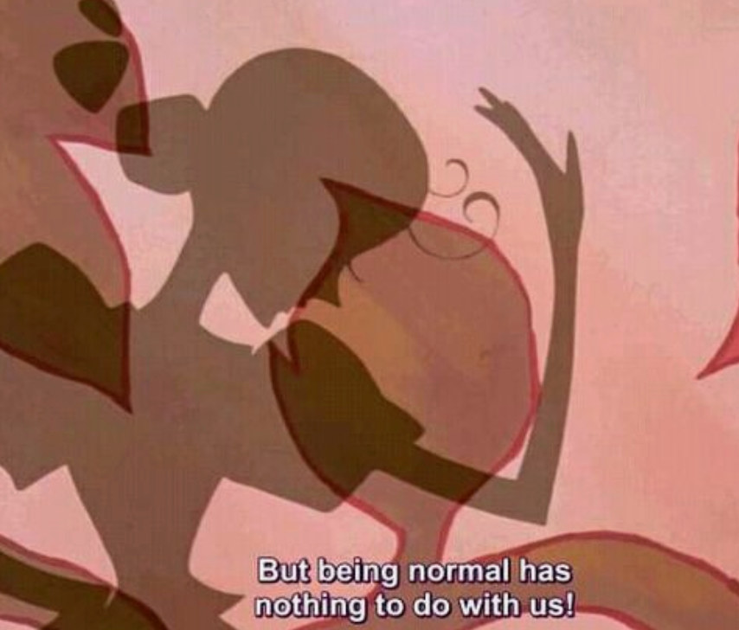
Why Care?
Improper mitigation leads to platforms under or over actioning, removing features or support unnecessarily, or contributing to abuse elsewhere
By targeting too closely the outcomes or aesthetics of abuse, platforms may miss the opportunity to target incentives, objectives and goals.

Slide 12
Privacy Ick
Improper Content Flags
Infinite Captcha
Banning VPN/ASNs
Lockouts, Poor Support
3P App Death
Pay-to-Spam Rate Limits
Archaic Real Names
Inconsistent Gating
SMS Shutdown

Slide 13
Twin Relationships
Adversarial (Security)
Focus on iterative squashing of bad actors
Mutualistic
Individualistic (Policy)
Focus on preventing single resources from scaling abuse

Slide 14

Capricious, Heartless, Lies
Scaled abuse is incentivized
Notes:
Grace talked about Privacy by Policy and the issue wherein that can lead to Trust required from the Platform to behave well.
No matter the frameworks, if we only count on Safety by Policy we count on actors not to use the platform as its been designed when in reality many actors conduct their abuse by repeatedly doing what a typical user would be able to do.
Most abuse of scale, whether its to promote hate, make money, or steal resources does so because it is possible to do so.

Slide 15
Propagating Endlessly
Scaling Prot Often Stumbles
Dan Luu’s “Disceconomies of Scale” saliently points out that larger platforms do not typically have better protections and their efforts at scaling mitigations can be ineffective, confusing, and lack clarity as to “why” something happened by targeting too many pieces of data made “illegible”
Notes:
Discuss work in Security and Safety. Mention Botnets, leaving security industry due to the inability of my employer to stop easily stoppable commodity botnets in favor of niche investigations and covering much of all consumer malware with ML models which would routinely miss attacks.
Mention clustering failures, but mention there is a time and a place for amassing a scaled approach to ML but its important to be specific and narrow the data to a use case outside just "entropy".
Legibility from DoS:
"the aggregate behavior of the system is beyond human understanding and even parts that could be understood often aren't because there are other priorities." --
From DoS:
A nice example of this is Gergely Orosz's story about when the manager of the payments team left Uber and then got banned from Uber due to some an inscrutable ML anti-fraud algorithm deciding that the former manager of the payments team was committing payments fraud. It took six months of trying to get the problem fixed to mitigate the issue. And, by the way, they never managed to understand what happened and fix the underlying issue; instead, they added the former manager of the payments team to a special whitelist, not fixing the issue for any other user and, presumably, severely reducing or perhaps even entirely removing payment fraud protections for the former manager's account.
From DoS:
Meme on "I Can't Count That Low" in regards to numbers like 100M.

Slide 16
(Accounts) Can be Nothing
Misfocus too late in the funnel
Accounts and Content on platforms can be similar to a single piece of malware or version of a malware family. It’s important to catch as early as possible, as narrowly and completely as possible.
Often necessary to remediate, but actioning them quickly will not disincentivize them from innovating if you do not understand what they want, why they succeed, or what the vulnerability is.
Notes:
Removing malware after its infected a machine is not effective.
Removing malware incompletely also is not effective.
Like it wouldn't be ideal to stop the ransomware but leave the infostealer? Or to stop the malware but leave the vulnerability? Or to catch it after its already stolen data? Picking the right AREA to focus requires often very specific knowledge of the platform in question and the goals of the malware or in this case a scaled abuse actor
If we think of a vulnerability remaining as always leaving an incentive for an attacker to return, then we can look at viewing safety similarily.

Slide 17

Oh, The Sound of Waves
Platform abuse ripples to others to further scale, enter obscurity
Email Addresses, Domain Registration, Purchase Endpoints, Data Breaches, Botnets, Account Takeovers, File/Image Storage, CDN, Server Time, Free Trials, App Store Listings, Ad Networks, Support, Reviews, Search Engines, Doxxing, Scraping
Notes:
"In Malware, Spam, Phishing and the like, larger resources, larger models, and single panes of glass have not solved these issues despite decades effort."

Slide 18
Even Light Casts Shadows
Platform failures should teach others starting out
Security knows that there is deep value in sharing malware and bad actor activity
Small platforms have outsized relief from spam due to clever, interesting designs
Large platforms often have context that grows obscure as they grow on exactly how effective some mitigations are
Independent researchers often cannot submit to bug bounties for non-exploit vulns

Slide 19
OK,
Don’t We Have Frameworks at Home?
Compliance (GDPR/DSA...)
Safety by Design/Default
Risk Assessments
Internal Policies

Slide 20
So What do you Propose?
More public resources on collaborative learnings from those reacting directly to scaled abuse not just on what works but who are the characters conducting this, how and why.
A Stab at a “Spampedia” Framework

Slide 21



Layoffs, burnout, and exhaustion cause a lot of folks to leave the industry, losing knowledge.
Why Now?
Safety is at risk from numerous “silver bullet” promise vendors as well as militarization similar to Security
Scaled abuse actors share techniques constantly, platforms do not.

Slide 22
L.O.R.E Framework

Slide 23
L.O.R.E
This is a work-in-progress reference tool of common scaled abuse actor goals, objectives, incentives, methods, and inversely platform surfaces, interventions, and design considerations. Similar to Security's MITRE ATT&CK framework, the much older Threat Hunting Project or the Malpedia for focused on online platform safety scaled abuses instead such as toll fraud, infrastructure abuse, spam, harassment, account gen, and scraping.
Learnings on Options & Reasons for Exploitation
Github

Slide 24

L.O.R.E
Disclaimer that this is a collaborative WIP, and is open to ideas, research, articles, essays, poetry, specs.
Its intent is to serve as a reference tool to organize definitions and collect references on viable (and nonviable) designs and mitigations for abuse as well as allow the formatting of those into User Journeys to action on explicitly.
Notes:
This is part of an initial proposal wherein I'm hoping to meet and work on normalizing the following every two weeks.

Slide 25
L.O.R.E
Long term after normalization the repository will move to a site to allow for querying by tags such as incentive, goal, surface, and mitigation to quickly find design and technical information on implementation.

Slide 26
Making a Pair
Imagining a Usage 101 for Risk Assessment
Search by Feature or Goals/Objective
Browse Journeys/Examples for help identifying how to find abuse
Research applicable Platform Mitigations
Construct, w/BYOB data a User Journey/Troupe for use internally
Attach to existing or ongoing risk assessment and Decide Changes
Contribute Any Additional Examples post-decision

Slide 27
Example User Journey
Troupe: Jovial Jesters
Goal: I want to Sell a Limited Skin
I’m dealing with an issue at a gaming company where we released a limited edition birthday skin for characters who log on during the event. They have a chance to get one of 20 festve costumes. The event is super popular, but we’ve noticed a huge increase in “stale” users who only seem to have joined for the event and I big increase in real users who appeal that we’ve deleted their account. The appeals seem real.

Slide 28
Example Journey (1)
Troupe: Jovial Jesters
Goal: I want to Sell a Limited Skin
Objective | Feature | Incentives/Motivations | Method
Create Account | Signup | I need to create many accounts because the skin is available 5% of the time I need an account to transfer to the buyer | A
Send and Verify Email | Email Verif | I need to verify my email to claim a skin I can’t message the buyer without verification Verified accounts are more likely to sell | A
Accept ToS | Policy | I can’t perform more actions without accepting ToS | A
Hibernate | -- | I need to pass time until activation I can’t claim a skin until my account is fully activated | A

Slide 29
Example Journey (2)
Troupe: Jovial Jesters
Goal: I want to Sell a Limited Skin
Objective | Feature | Incentives/Motivations | Method
Check Life | Various | I need to do a common action regularly to test the account is alive I want the account to seem legitimate | A
Acquire Skin | Reward | The skin is limited edition and not garunteed This skin in game has a silly dance, which is unique | A
Check Skins | Items | I am not garunteed to have the skin I therefore have to validate that I see it in my inventory | A

Slide 30
Example Journey (3)
Troupe: Jovial Jesters
Goal: I want to Sell a Limited Skin
Objective | Feature | Incentives | Method
Hibernate | -- | I did not get the skin I could sell the account as part of a bulk package later I need to do more things to sell the acount in bulk so I’ll wait for now If I met too much friction I’ll hibernate until I can bypass it | A
Change Email to Buyer | Settings | I got the skin If I don’t change the email, the buyer may think its a scam If I | A
Buyer Signs In | Login | I got the skin The Buyer should log in and confirm receipt of a sample of accounts The buyer might complain or discredit me if they can’t test | M
Notes:
Sells Hydrated accounts on Etsy to largely real users.
Targeting the users too late after sale may mean a user who wanted to use the platform legitimately may end up paying a third party for a product that is no longer available, punishing potentially the benign user and not disincentivizing Jovial Jesters at all.
Targeting the skin acquisition object and interrupting that with an intervention say by detecting their automation, or by clustering the accounts via machine learning and requiring a captcha may lead to another hibernation step, or immediately lead the account to enter bulk sale for more nefarious purposes.
The scaled abuse here is multi-part, and choosing the right intervention is difficult.
It also helps illuminate truer definitions of "spammer" or "bot" then an organization may have been able to articulate before and expose areas where their harm has not been fully remediated or could be re-used. Similar to malware being only partially cleaned and repopulating itself. You can stop this user journey but it may re-route.
Ultimately definitions and really all of this is up to you and how you use it, but the kind of work though that has immense reward for not only better clarity into user experiences, but an ability to articulate to leadership and users more than "We have 700K fake accounts per month" but "we have 50K Jovial Jesters" and we have "650K Mean Potatoes". In operational spamfighting as well you can look at clusters of abuse that escaped detection and apply these kind of journeys to help segment which % of accounts that are uncaught go on to belong to a particular journey in the end.
Dan Luu's essay I discussed earlier speaks to the issue of "Legibility" in Scale. I hope that by trying to define frameworks like these and share them we can encourage much more legibility in understanding abuse.

Slide 31
Contrived World
Instead of easing an abuse journey we want to add objectives, change incentives, or eliminate the value of the goal at all
Notes:
Now the prior pages are incredibly difficult to collect and aggregate those user journeys without engaging your security and safety operational teams to help identify examples of users impacted or accounts working toward goals. In creating typical User Journeys employees may do their own testing or use live active employees to see and map out possible ways for them to experience your platform.
Again with regards to legibility, many areas in policy are written with a mind to things that are visible easily to a user who is experiencing a harm and can report it to us in some way. Happy things are easily visible, things that can be reported are easily visible. But many User Journeys like this one have a user who could be impacted that won't be able to report it to us for fear of reprisal on their other account, and the fact that they know buying accounts is against ToS but we as a platform incentivized it with our limited jovial jester skins.
Any type of harm outcome such as hate, fraud, harassment, stalking, theft, doxxing, can generally be scaled. Trust & Safety and Scaled Abuse teams are incredibly natural partners and fits then to make sure to have both of at your organization so that both can assure that policy and mitigations are properly chosen.
Similarily, if we have any surfaces that aren't reportable, or a type of content that is not covered we may find that in order to find that content we need to seek out who is scaling to achieve it.

Slide 32
Twins by Duty
In parallel we can compare any friction we introduce to existing legitimate happy user journeys.
Notes:
Kinda feeling like kill chains? Are user journeys kill chains?
Anyhow, by reframing spam and abuse as a user journey we can view mitigations as interacting directly with that journey and thereby that relationship.

Slide 33
Components
Mitigations
Designs can be any standard mitigating feature strategy
Designs changes typically change whole incentives
Interventions typically don’t change incentives
Interventions typically prevent incentives from succeeding by targeting the action based on the method, or the resource directly.
Notes:
A Signup Design may be implement an invite-only system or require verification for all users.
A Signup intervention may be to captcha users you suspect of using a scaling method.

Slide 34
Components (2)
Examples
The place for context
Associated with either the Mitigation or the Abuse Goal
Articles, RFC, Research, Post-Mortems, Queries, Poetry

Slide 35
Isolation vs Outbreak
BYOD(ata)
Applicable Internal Policies
Applicable Data (Metrics, Signal, Ready Mitigations)
An appropriate name, if applicable for a group of user journeys
“Toll Fraudsters” may have many journeys but one “Troupe”
Your best drawing of what you think their favorite animal is
Notes:
BYOD(ata)
Applicable Policies
Applicable Data (Metrics, Signal, Ready Mitigations)
An appropriate name, if applicable for a group of user journeys
“Toll Fraudsters” may have many journeys but one “Troupe”
Your best drawing of what you think their favorite animal is

Slide 36
Case Study:
TownHall
.Social

Slide 37


Townhall.Social
The place to be seen and heard
Our new social media network for civil elected officials to talk with civilians is having a realm of issues.

Slide 38
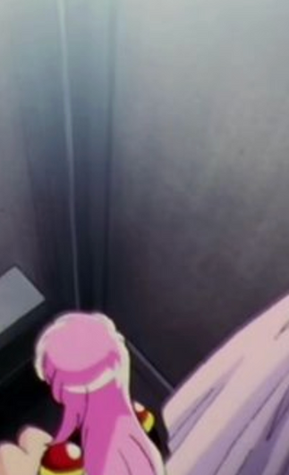
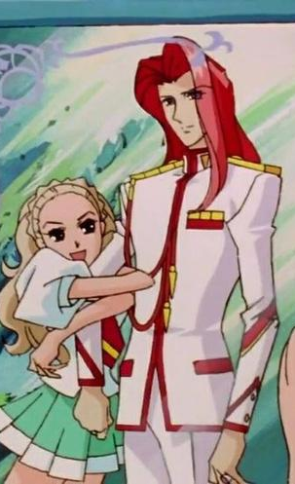


Contrivance of Personalities
Signup Spam
Password Spray
SMS Abuse
Non-consensual Messaging
Image Scraping

Slide 39
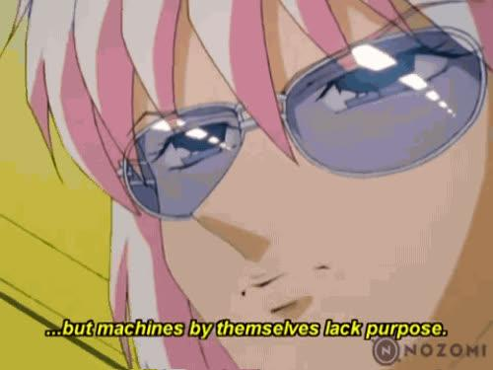
Optical Illusions
We Can Differentiate Mulitple Forms of SMS Abuse
You may see any SMS abuse separated by Objectives and Incentives, and Features
Toll Fraud via Unverified Messages
Mass Verification for Generation
Mass Verification for Harassment
Mass Verification fro Account Theft

Slide 40
Troupe: Silly Salamander
Journey: Creating fake engagement to qualify for ads
Category: Financial
Goal: I want to qualify for ads
Example Incentives:
“If I sign up for verified accounts...I can like unlimited posts per account...reaching 10,000 views allows me to monetize ads fast”
Example Mitigations: Invite Based Signups, Activation Wait, Mandatory Review, Require Re-Verification, Unlink Engagement from Ads, etc.
Signup

Slide 41
Troupe: Passive Parrot
Journey: Compromising Users for Ransom
Category: Financial
Goal: I want extort money from compromised users
Example Incentives:
“With credentials found in other breaches I can access many accounts...”
Example Mitigations:
Verify Original Email, Account Data Security Questions, etc.
Password Spray

Slide 42
Troupe: Trecherous Tortiose
Journey: Toll Fraud via Account Updates
Category: Financial
Goal: I want to receive text messages upon request
Example Incentives:
“If I leverage existing accounts I could send request multiple text messages per account...I can make a cut of money for each 1000 text messages I send toward a premium carrier...”
Example Mitigations(s): User Initiated SMS, Captcha, Rate Limits, etc.
Toll Fraud

Slide 43
Troupe: Malicious Manatee
Journey: Phishing Strangers via Private Message
Category: Resource
Goal: I want to steal credentials to use on other platforms
Example Incentives:
“
Example Mitigations: Account Security Image, Warning When Leaving Site, Disallow Redirects, Disallow Link Masking, Link Click Unavailable without MFA, etc.
Messaging

Slide 44
Troupe: Sneaky Shark
Journey: Scraping Profile Pictures from Reviews
Category: Theft
Goal: I want to steal images to use in deepfakes and sale
Example Incentives:
“I can access a large amount of image data without a user account of my own...This image data is immediately valuable for training or hate”
Example Mitigations: Poison or Consent to Poison Image Set, Allow Consent to Limit to Verified Accounts, Sinkhole Infrastructure for Scrapers, etc.
Scraping

Slide 45
We Don’t Need to Reinvent the Wheel
Scaled Abuse is Not New
But We Do Need to Accept that There is No Silver Bullet and Get Granular

Slide 46
Closing Thoughts + Resources

Slide 47
Ditch scaling culture
Ditch kill chain culture
Be more curious. Frame actors as having a user journey that is legitimate to your design
On Nonscalability
Notes:
"Vulnerability" language is often ineffective in moving Security or Safety spaces. Hence why bug bounties don't often allow for things such as a websites dangling URLs, or use of their service in an inappropriate way. It isn't a "vulnerability" per se that researchers are incentivized to work with social media to resolve if say a particular image will get a user banned. so try something new and frame scaled abuse as something that we designed to create.
Whenever we do NOT include safety by design we are designing to be abused.
From On Nonscalability
How is scalability created? It is not a necessary feature of the world. People
stumbled on scalable projects through historical contingencies. They cobbled
together ways to make raw materials (for both goods and knowledge) self-
contained and static, and thus amenable to expansion. In European sugarcane
plantations, the natives were wiped out; exotic, coerced, and alienated plants and
workers came to substitute for them. Profits were made because the general mess
of extermination and slavery could be discounted from the books. Such histori-
cally indeterminate encounters formed models for later projects of scalability.
Do we live in a world of scalable nonsocial landscape elements—nonsoels?
Yes and no. The great “progress” projects of the last several centuries have built
on the legacy of the colonial plantation to make scalability work in business,
government, and technology. But scalability has never been complete. In recent
years, changes in global capitalism have challenged the assumption of scalability
for labor and natural-resource management, and at least some theorists in the
social sciences have pointed out the malevolent hegemony of precision. Mean-
while, critics of scalability have raised distress signals about the fate of biological
and cultural diversity on earth. It is an important time to develop nonscalability
theory as a way to reconceptualize the world—and perhaps rebuild it.

Slide 48



This stuff is super simple until it’s not
Wrap-up
Keep trying.
Don’t run from the effort.
If you can’t change the incentives, target the root method explicitly as specifically as possible before targeting the final harm

Slide 49
Finally
There are many areas this is not easily applicable to and that have well established frameworks such as for many types of high harm and exploitation.

Slide 50

Next Steps
Checkout Resources
Contribute or Give Feedback on LORE
Collaborate on upcoming botting zine?

Slide 51
On Scaling and Abdicating Accountability
Dan Luu’s Diseconomies of Scale
Anna Lowenhaupt Tsing's On Nonscalability
Malpedia and “Spampedia” Proposal
Resources
Fraunhofer FKIE’s Malpedia
L.O.R.E. Github
Notes:
I really heavily recommend reading in full as well as all the citations from Dan Luu's "Diseconomies of Scale" and Anna Lowenhaupt Tsing's "On Nonscalability".
The latter, "On Nonscalability" is formative in putting words to many experiences surrounding how efforts to ascribe precision, growth, and scale to diverse human systems has roots in history.
I've also linked Fraunhofer FKIE's "Malpedia" which I used heavily during my time in malware research and mitigation and was a basis for thinking through the need for something similar to Spam.

Slide 52
Why Single-Signal IP Blocking Is Foolish
“Resident Evil” Residential Proxy Research Paper
HUMAN's "PROXYLIB" on Residential Proxy Malware
Residential Proxy Lawsuit, Theft via Luminati/OxyLabs
Resources
Trust & Safety Professionals Assoc Definitions
TSPA's Policy Abuse Types
Notes:
I've also included a few examples here from how earlier in the talk I derided the use of blocking VPN/Proxy ASNs outright from platform access. Much of the reasons there lie in the unreliability of the feeds those platforms use to determine "VPN" usage and that many scaled abuse actors are not coming from paid VPN services but from residential proxies sourced on consumer ISPs that are often propagated by malware, have users unknowingly consent to, or pay users in low-income situations to share bandwidth for. Actioning then on this as single-signal will likely lead to little impact in abuse, heavy user impact, and a bad time for your support staff.
I've also linked the TSPA's "Abuse Types", which cover some standard definitions for more high harm areas of abuse. The TSPA also has a good wealth of other documentation on Trust & Safety policy topics.

Slide 53
Anti-Theft w/Poison, Quicksand, Consent
U of Chicago’s “Nightshade” and “Glaze”
404 Media’s “Content Farm Sinkholes Scraping”
Tech Crunch’s “FanFic Writers Lock Their Accounts”
Resources
Writing Text that Screen Readers will Ignore on SO
My Talk on Abused Platforms Scaling Harm
My “Cheap Shot: Hunting Low Cost Attacker Infra”
Notes:
I've linked resources on ways to mitigate scraping & theft from your site outside of rate limiting through design choices. Elective (or mandatory) poisoning through Nightshade/Glaze would be experimental but potentially effective in discouraging entire swathes of theft while also imposing cost on the operation.
For non-images you can likely take a leaf from stuff I learned writing mitigations for malicious email campaigns, where attackers would avoid or confuse text models with repetitive HTML and CITE statements. This could likely be retrofitted with caution to avoid poisoning text that Screen Readers might pick up while muddling any scraper attempting to lift the page text itself.
Same with Sinkholing scrapers through subdomains or honeypots of various kinds or simply taking a leaf from AO3 and allowing users to electively keep their work and posts from being visible by non-authenticated users.
Also feel free to check out my previous talk on hunting malware actors by looking for patterns in the the scaled resource platforms they are likely using for their attacks. This'll have more context on the way that not taking action facilitates off-platform abuse.

Slide 54
Security Q’s Suck + Why They Could be Great
Bo Ruberg’s “What is Your Mother’s Maiden Name?”
“Secrets, Lies, and Account Recovery” Research Paper
Guild Wars 1 Security Question Patch Lore on Reddit
Resources
Affordable MFA Image Options to Min ATO
Blackberry OS's Dead Location to Picture Password
Okta’s Security Image Deprecation
Notes:
Another favorite resource for designing for safety is Security Questions. They are very not good, IF they are done how we are used to seeing them. There's a lot of reasons to not use "Maiden Name" or anything that encourages users to use random values. However I've linked a favorite case study from Guild Wars 1 in the use of INTERNAL data the user can select such as character name, which allows easy remembrance of the Answer, discourages scaled ATO, and can be easily adjusted to fit values that your platform offers instead. It's also a great and accessible way to offer more accounts protection that isn't MFA which users often don't enable and avoid due to privacy reasons.
Speaking of account protection alternatives outside of MFA, there are two "Dead Tech" alternatives from Blackberry and Okta which can be retrofitted to prevent phishing pages mimicking your website by showing users an image of their choosing ("Security Image") or requiring a user to match an overlay on top of an image to a location on the image ("Picture Password"). These were really cool, usable pieces of tech which absolutely can still have their uses preventing scaled abuse!

Slide 55
Free Antibot Tools, Tips, Trick, Analysis
Abraham Juliot’s “CreepJS” Fingerprinting Research
FingerPrintJS’s “BotD” for Simple Scripting Detection
Niespodd’s Antibot Evasion Analysis
Resources
Quick + Dirty Free "Captcha" Solution Discussions
Invite Systems, Activation Time Example
Cohost's Activation Types and Invites
Notes:
And once you've got your design figured out (or not!) I've also linked a series of affordable or free antibot solutions in the form of free captcha options, scripting detection packages that aren't cloudflare, and some anti-bot analysis to help you understand more about what tools are out there to avoid your interventions and the networking involved when you're ready to write your own bot mitigations.
And lastly from the Anti-Software Software Club, I really enjoyed Cohost.org's breakdown of exactly what an activated versus non-activated account can do on their platform

Slide 56
Thank You!
LORE
I’m A Car Now
Notes:
Thanks again for listening to this talk!
create cool stuff, break bad bots, fix the internet by fixing your stuff!

